Slide 1
Teacher Access How to view Care Plans, Health Conditions, Emergency Information on Skyward
By: Nurses…

Slide 2
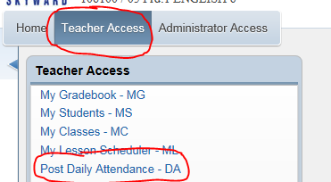
How to view Student Indicators in Attendance screen?
Click Teacher Access
Click Post Daily Attendance
Select your Class by click “By Name”

Slide 3
Student Indicators
To the left of each students name there will be a ‘Student Indicator’ corresponding to that students needs.
To view what each Student Indicator means click on the Indicator.
Examples:
H – Health Condition
P – Individual Health Plan
Orange box – Critical Alert

Slide 4
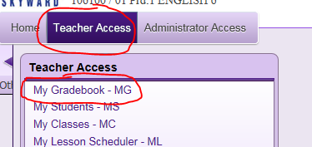
How to view Student Indicators in Gradebook screen?
Click Teacher Access
Click My Gradebook
Select your class by clicking “Gradebook”

Slide 5
Student Indicators
To the left of each students name there will be a ‘Student Indicator’ corresponding to that students needs.
To view what each Student Indicator means click on the Indicator.
Examples:
Red Cross and Students name Highlighted in RED – Health Condition
Red Exclamation Mark – Critical Alert Information

Slide 6
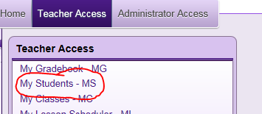
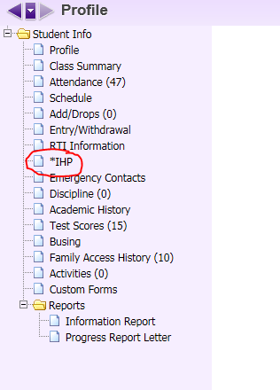
View Health Plans in Skyward
Click Teacher Access
My Students
Find the student and click select (You can search in the bottom right hand corner)
Once you find the student click IHP on the left hand side
You can now print the Individual Health Plan by clicking the
print button.

